Slide 1


A Presentation
On
Eigenvalues and Eigenvectors
By
Mr. Urmila Navaghan
Faculty of Engineering Mathematics
F. Y. B. Tech. Dept.
G. H. Raisoni College of Engineering & Management

Slide 2
Eigenvalues and Eigenvectors.
Definition : A nonzero vector x is an eigenvector (or characteristic vector) of a square matrix A if there exists a scalar λ such that Ax = λx. Then λ is an eigenvalue (or characteristic value) of A.
Every constant multiple of an eigenvector is an eigenvector, meaning there are an infinite number of eigenvectors. There are a finite amount of eigenvalues. Each eigenvalue will have its own set of eigenvectors.
Note: The zero vector can not be an eigenvector even though A0 = λ0. But λ = 0 can be an eigenvalue
Eigenvalues: Each n x n square matrix has n eigenvalues that are real or complex numbers.
Eigenvectors: Each eigenvalue has infinite eigenvectors.

Slide 3
Geometric interpretation of Eigenvalues and Eigenvectors
An n×n matrix A multiplied by n×1 vector x results in another n×1 vector y=Ax. Thus A can be considered as a transformation matrix.
In general, a matrix acts on a vector by changing both its magnitude and its direction. However, a matrix may act on certain vectors by changing only their magnitude, and leaving their direction unchanged (or possibly reversing it). These vectors are the eigenvectors of the matrix.
A matrix acts on an eigenvector by multiplying its magnitude by a factor, which is positive if its direction is unchanged and negative if its direction is reversed. This factor is the eigenvalue associated with that eigenvector.

Slide 4
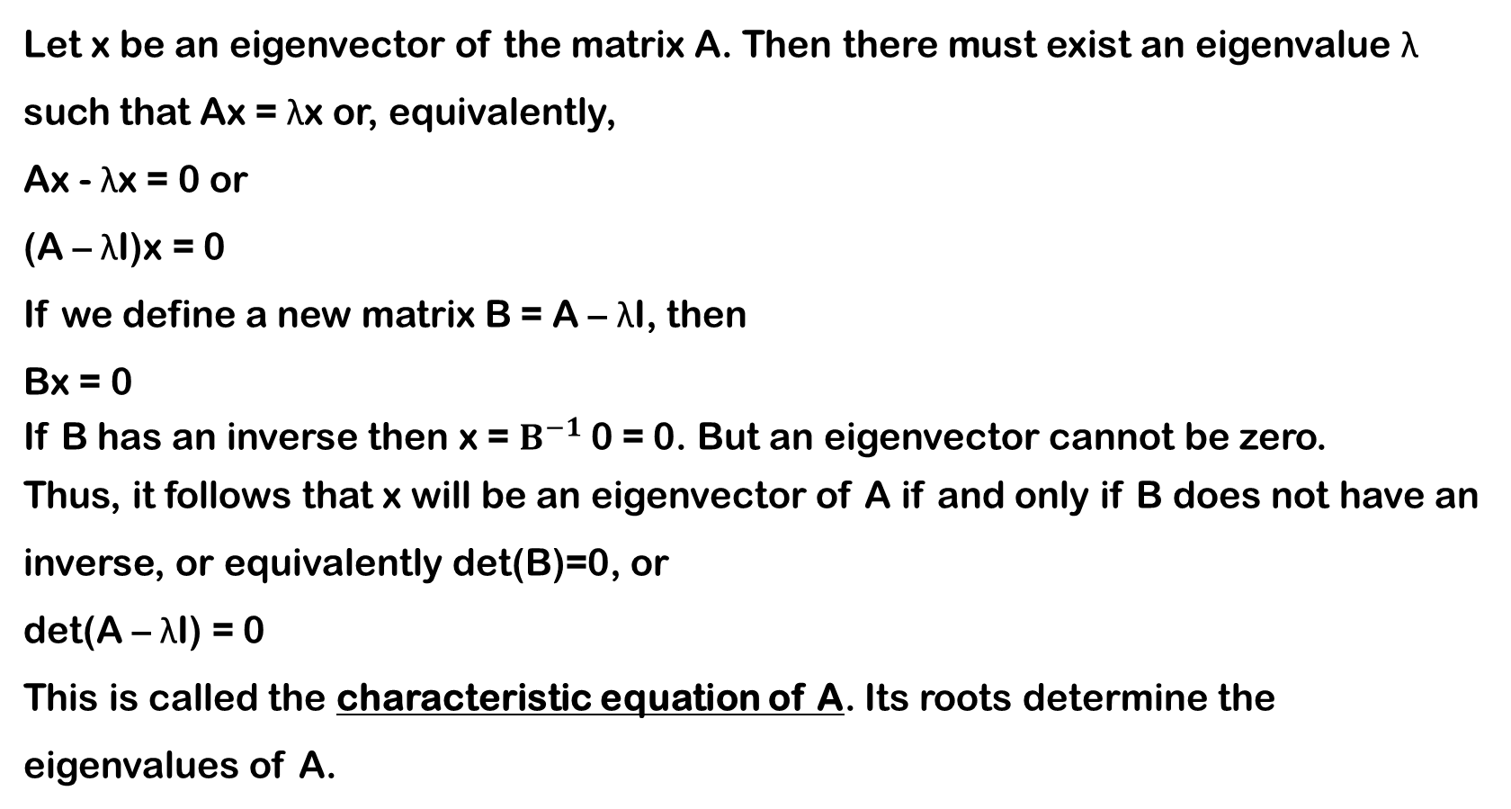
Eigenvalues
Let x be an eigenvector of the matrix A. Then there must exist an eigenvalue λ such that Ax = λx or, equivalently,
Ax - λx = 0 or
(A – λI)x = 0
If we define a new matrix B = A – λI, then
Bx = 0
If B has an inverse then x = $B^{−1}$0 = 0. But an eigenvector cannot be zero.
Thus, it follows that x will be an eigenvector of A if and only if B does not have an inverse, or equivalently det(B)=0, or
det(A – λI) = 0
This is called the characteristic equation of A. Its roots determine the eigenvalues of A.

Slide 5
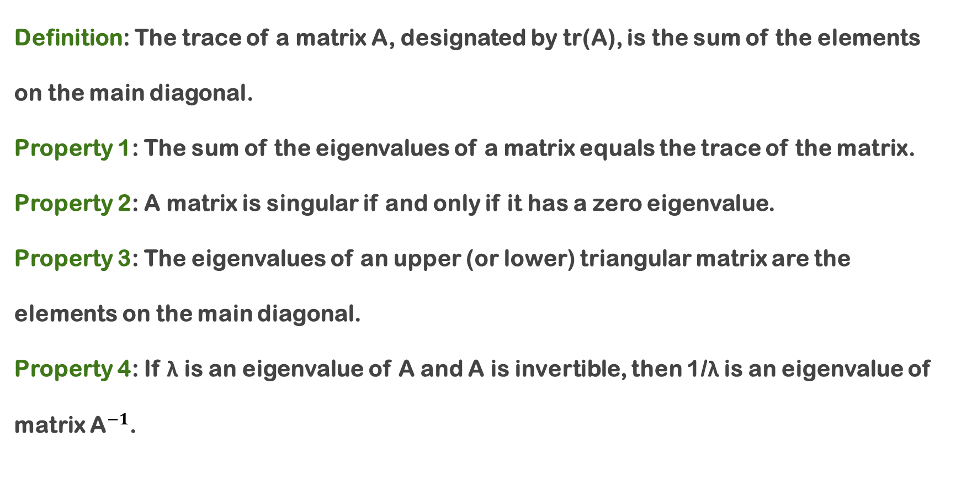
Properties of Eigenvalues and Eigenvectors
Definition: The trace of a matrix A, designated by tr(A), is the sum of the elements on the main diagonal.
Property 1: The sum of the eigenvalues of a matrix equals the trace of the matrix.
Property 2: A matrix is singular if and only if it has a zero eigenvalue.
Property 3: The eigenvalues of an upper (or lower) triangular matrix are the elements on the main diagonal.
Property 4: If λ is an eigenvalue of A and A is invertible, then 1/λ is an eigenvalue of matrix ${\text{A}}^{−1}$.

Slide 6
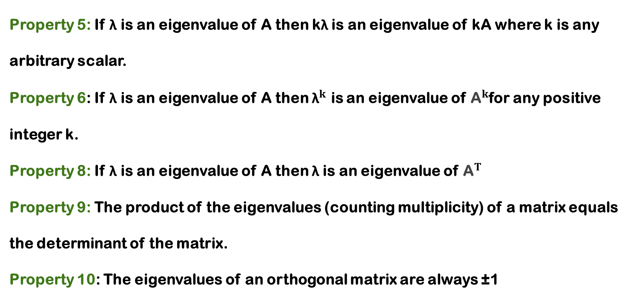
Properties of Eigenvalues and Eigenvectors
Property 5: If λ is an eigenvalue of A then kλ is an eigenvalue of kA where k is any arbitrary scalar.
Property 6: If λ is an eigenvalue of A then ${\text{λ}}^{k}$ is an eigenvalue of ${\text{A}}^{k}$for any positive integer k.
Property 8: If λ is an eigenvalue of A then λ is an eigenvalue of ${\text{A}}^{T}$
Property 9: The product of the eigenvalues (counting multiplicity) of a matrix equals the determinant of the matrix.
Property 10: The eigenvalues of an orthogonal matrix are always ±1

Slide 7
Procedure to find eigenvalues and eigenvectors of a Matrix A of order n
Step 1: Set up the characteristic equation, using |A − λI| = 0
Step 2: Solve the characteristic equation, giving us the n eigenvalues
Step 3: Substitute the eigenvalues into the Characteristic matrix
(A − λI)x = 0
Step 4: Solve the system (A − λI)x = 0 to find x
Step 5: The resulting values form the corresponding eigenvectors of A (n eigenvectors for a nxn system)
Note: The roots of the characteristic equation can be repeated. That is, λ1 = λ2 =…= λk. If that happens, the eigenvalue is said to be of multiplicity k.

Slide 8
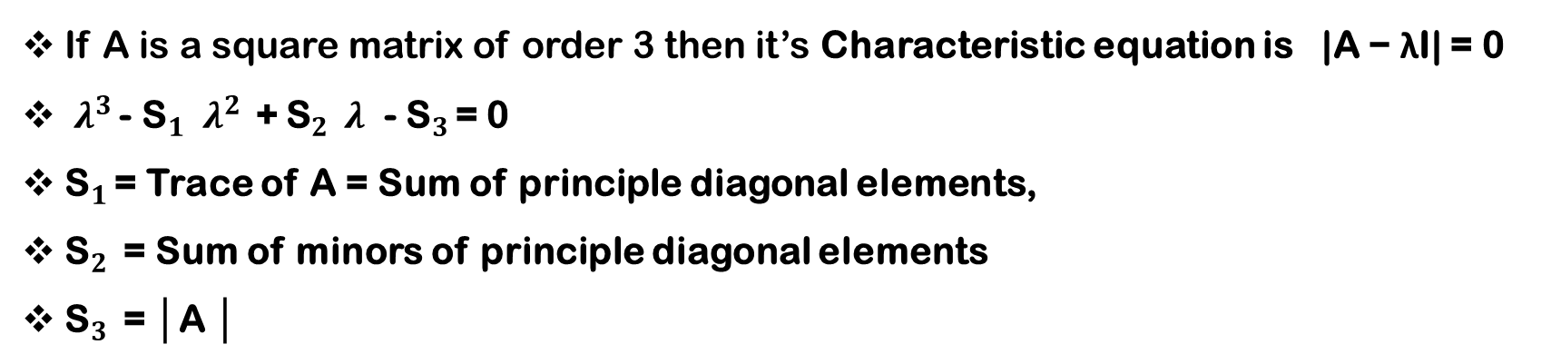
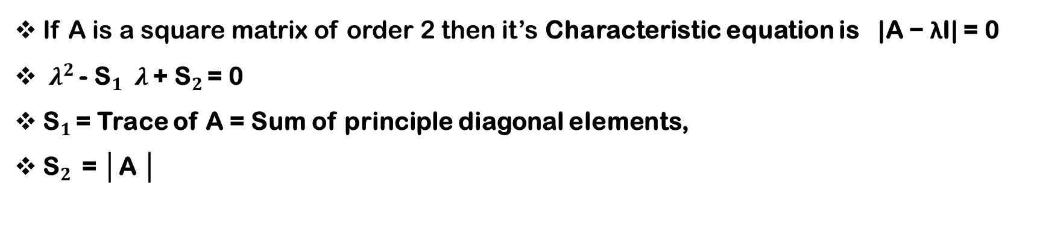
Short cut method to solve Characteristic equation
|A − λI| = 0
If A is a square matrix of order 2 then it’s Characteristic equation is |A − λI| = 0
$λ^{2 }$- ${\text{S}}_{1 }$ $λ$ + ${\text{S}}_{2 }$= 0
${\text{S}}_{1 }$= Trace of A = Sum of principle diagonal elements,
${\text{S}}_{2 }$ = │A │
If A is a square matrix of order 3 then it’s Characteristic equation is |A − λI| = 0
$λ^{3 }$- ${\text{S}}_{1 }$ $λ^{2 }$+ ${\text{S}}_{2 } λ$ - ${\text{S}}_{3 }$= 0
${\text{S}}_{1 }$= Trace of A = Sum of principle diagonal elements,
${\text{S}}_{2 }$ = Sum of minors of principle diagonal elements
${\text{S}}_{3 }$ = │A │

Slide 9
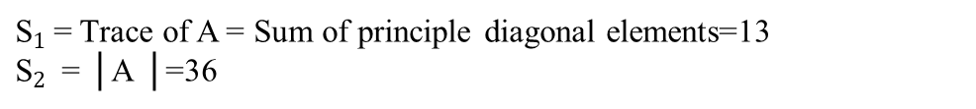
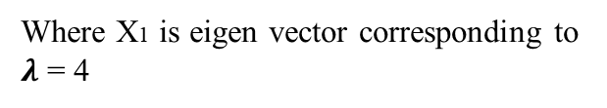
Examples
Solution: Let
The Characteristic equation is
Where X1 is eigen vector corresponding to $λ$ = 4
${\text{S}}_{1 }$= Trace of A = Sum of principle diagonal elements=13
${\text{S}}_{2 }$ = │A │=36
Eigen values are
Where X2 is eigen vector corresponding to $λ$ = 9

Slide 10
Example 2:
Solution:

Slide 12
Example 3:Find eigen values and eigen vectors for
Solution:

Slide 13
Example 4: Find eigen values and eigen vectors for
Solution:

Slide 14
Solve the following questions
Q.1 Find the sum and product of the eigenvalues of the given Matrices
1)
2)
Q.2 If 3 and 15 are two eigenvalues of the Matrix then find │A │without expanding the Determinant.
Q.3 If 3 and 2 are two eigenvalues of the Matrix A= then find value of a.
Q.4 If 2 is eigenvalues of the Matrix then find remaining eigenvalues.
Q.5 Find eigenvalues and Eigenvectors of the given Matrices
1)
2)
3)
4)

Slide 15


